Slide 1
Team Dynamics:
Harness Conditions for Team Success

Slide 2
Agenda
• Understanding Team Dynamics
• Hackman’s Conditions & Wageman’s Enhancements
• Conflict Resolution Tools
• Fluid Roles & Individual Contributions
• Activity Overview
Notes:
In our session today, we’ll begin by understanding what team dynamics are and why they matter. Then, we’ll review key research—Hackman’s conditions for effective teams and Wageman’s enhancements. Next, we’ll dive into conflict resolution tools and the idea of fluid roles based on Belbin’s model, and finally, we’ll preview our interactive activities.

Slide 3
Understanding Team Dynamics
• Patterns of interaction, communication, and behavior
• Built on trust, flexibility, and effective conflict management
• Critical for collaboration, innovation, and performance
Notes:
When we talk about dynamics, we refer to the ways in which we communicate, build trust, and manage conflicts. Strong team dynamics are essential for fostering innovation and achieving shared goals
Team dynamics refer to how individuals interact, communicate, and work together. This concept isn’t just about personalities—it covers the structure, roles, trust levels, and even how conflicts are managed. In today’s fast-paced, knowledge-based work, understanding these dynamics is crucial for high performance and innovation.

Slide 4
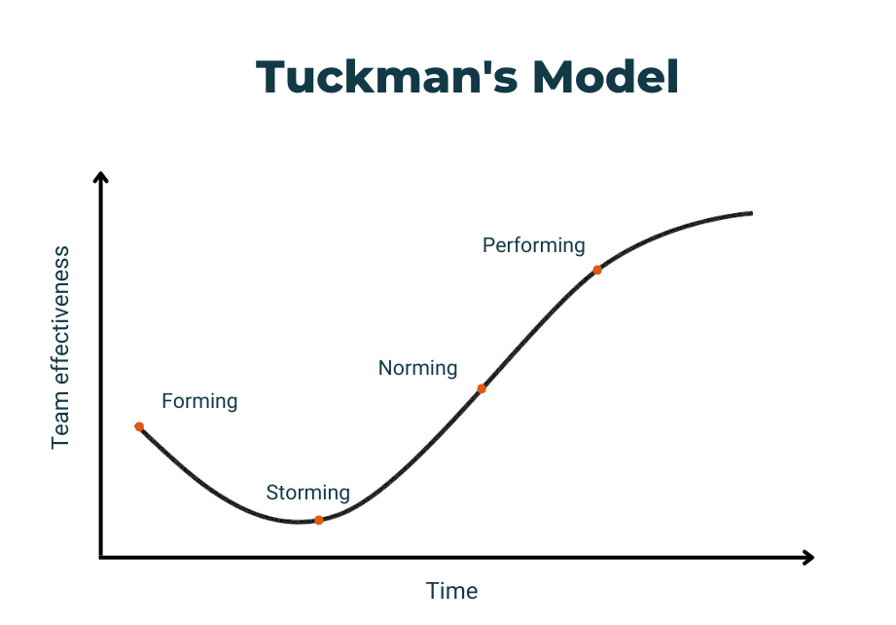
Notes:
Tuckman’s model is a well-known heuristic that outlines the typical phases teams go through—forming, storming, norming, performing, and sometimes adjourning. It’s been widely used in training because it offers a relatable narrative about team development. However, it’s primarily based on observations rather than robust empirical research, and it doesn’t really address the actionable elements of building an effective team.
Tuckman’s model is a useful starting point, our goal is to move beyond merely diagnosing team stages to actively creating conditions for success—something Hackman’s model supports with actionable strategies

Slide 5
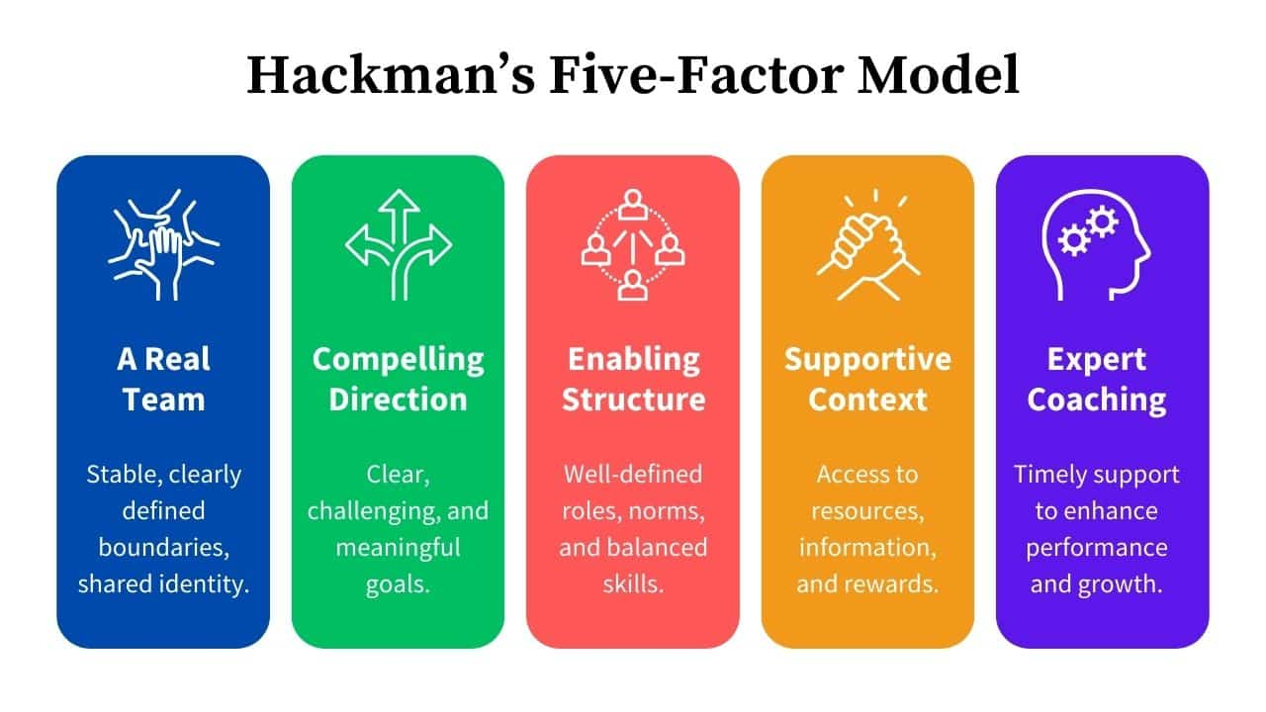
The Algorithm – Hackman’s Conditions for Team Success

Slide 6
1) A real team
The group is a real team, rather than a team ‘in name only.’ This means it should be:
bounded: it’s clear who’s in it, and who isn’t
stable: the membership of the team is not constantly in flux
interdependent: they rely on each other to accomplish their overall work.
They count on each other and work together as a unit.
Take note: if your ‘team’ do not share responsibilities, rely on each other to get things done, and have a common goal, then you might be managing a group of people or functional department, but not an actual team. And that’s OK!

Slide 7
2) A compelling direction
The team has a clear direction, and it is a direction that energizes and orients and engages the members. This includes understanding the team's mission and goals.
Set clear, ambitious, but achievable goals for your team that align with the company's broader mission and objectives. These should be goals that motivate and engage your team. Make sure that these goals are communicated clearly and frequently.

Slide 8
3) An enabling structure
The team is designed and managed to facilitate rather than impede teamwork. The work design, team composition, and core norms of conduct foster competent team performance.
Ensure that the team's composition and structure support its goals. This can involve considering the mix of skills and personalities within the team, and adjusting as necessary. Also, establish norms of conduct that promote positive and productive behavior, such as mutual respect, open communication, and constructive feedback.

Slide 9
4) A supportive context
The organization provides resources, information, and rewards to support the team's work. There is an organizational context that supports teamwork, including a reward system that reinforces good team behavior, an educational system that develops necessary skills, and a supportive and responsive leadership.
Advocate for your team within the broader organization to ensure they have the resources and support they need to do their work effectively. This might involve negotiating with other departments for resources, or lobbying senior management for greater support. Also, ensure that good team performance is recognized and rewarded.

Slide 10
5) Expert coaching
When team members need help with task strategies, teamwork, and group dynamics, they can get it. The team leadership and coaching from the manager is aimed at helping the team to grow and develop, to overcome obstacles and to achieve its goals.
Provide coaching and feedback to your team members to help them improve both their individual skills and their ability to work as a team. This might involve regular one-on-one meetings, group training sessions, or bringing in an external coach or trainer. Be open to receiving feedback as well, and show a willingness to improve your own skills and behaviours as a manager.

Slide 11
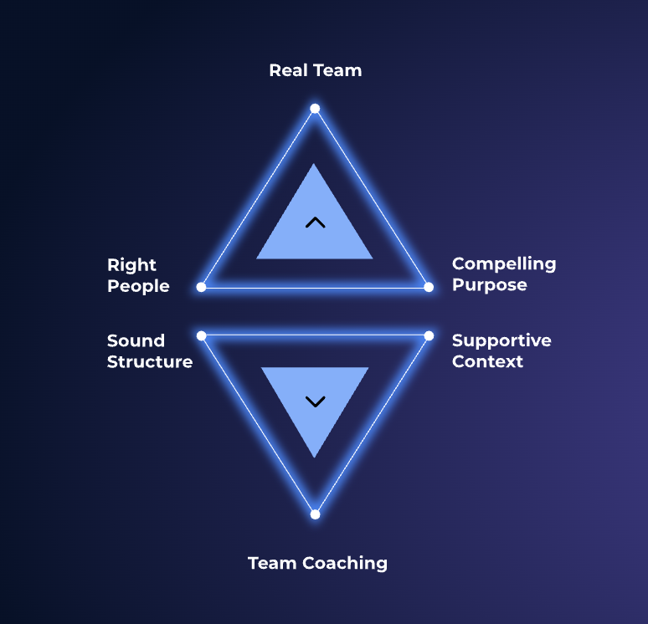
Temporal Entanglement – Wageman’s Expansion
• Shared Accountability: Every member is responsible for team outcomes
Example: Proactively supporting one another’s work.
• Dynamic Team Coaching: Leadership that is distributed and evolves
Example: Informal peer feedback and adaptive mentoring as challenges emerge.
Notes:
Wageman builds on Hackman’s model by emphasizing that effective teams also require shared accountability—where everyone feels responsible for the team’s success—and dynamic coaching that isn’t fixed to one individual but flows throughout the team. This approach empowers every associate to contribute actively and supportively

Slide 12
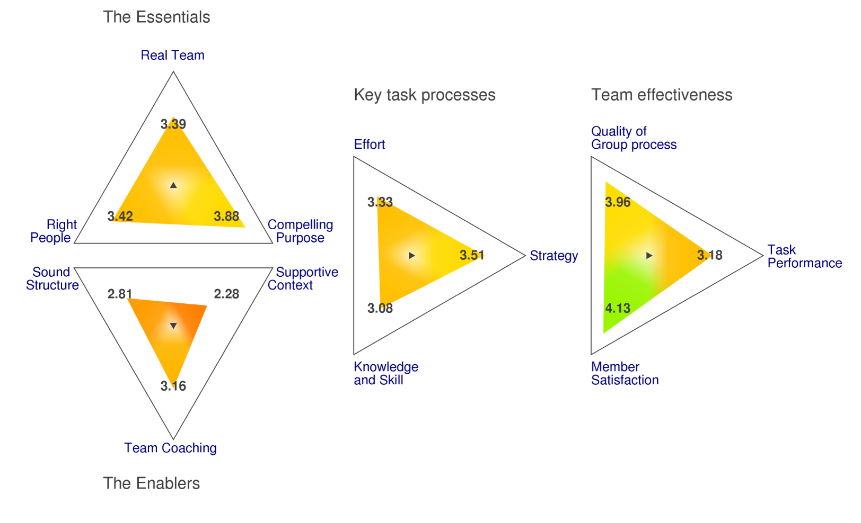
Team Diagnostic Survey

Slide 13
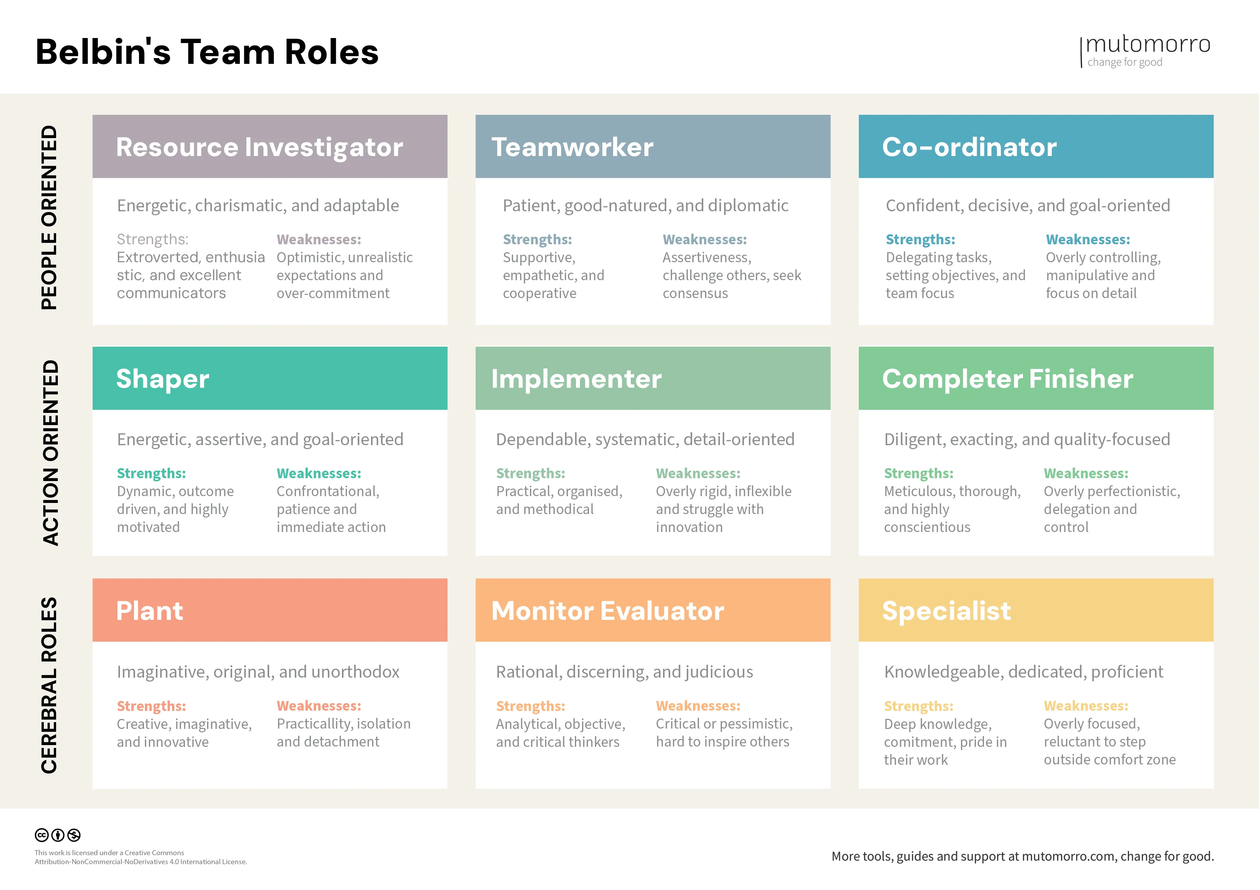
Belbin’s Team Roles
Notes:
Important to remember that
if you are not a plant, but you can play a plant role and adapting to the situation and playing different roles as needed contribute to effective teamwork
If you box yourself in it is harder to learn and grow and team dynamics and team performance will suffer is not adaptive (structure/context)

Slide 14
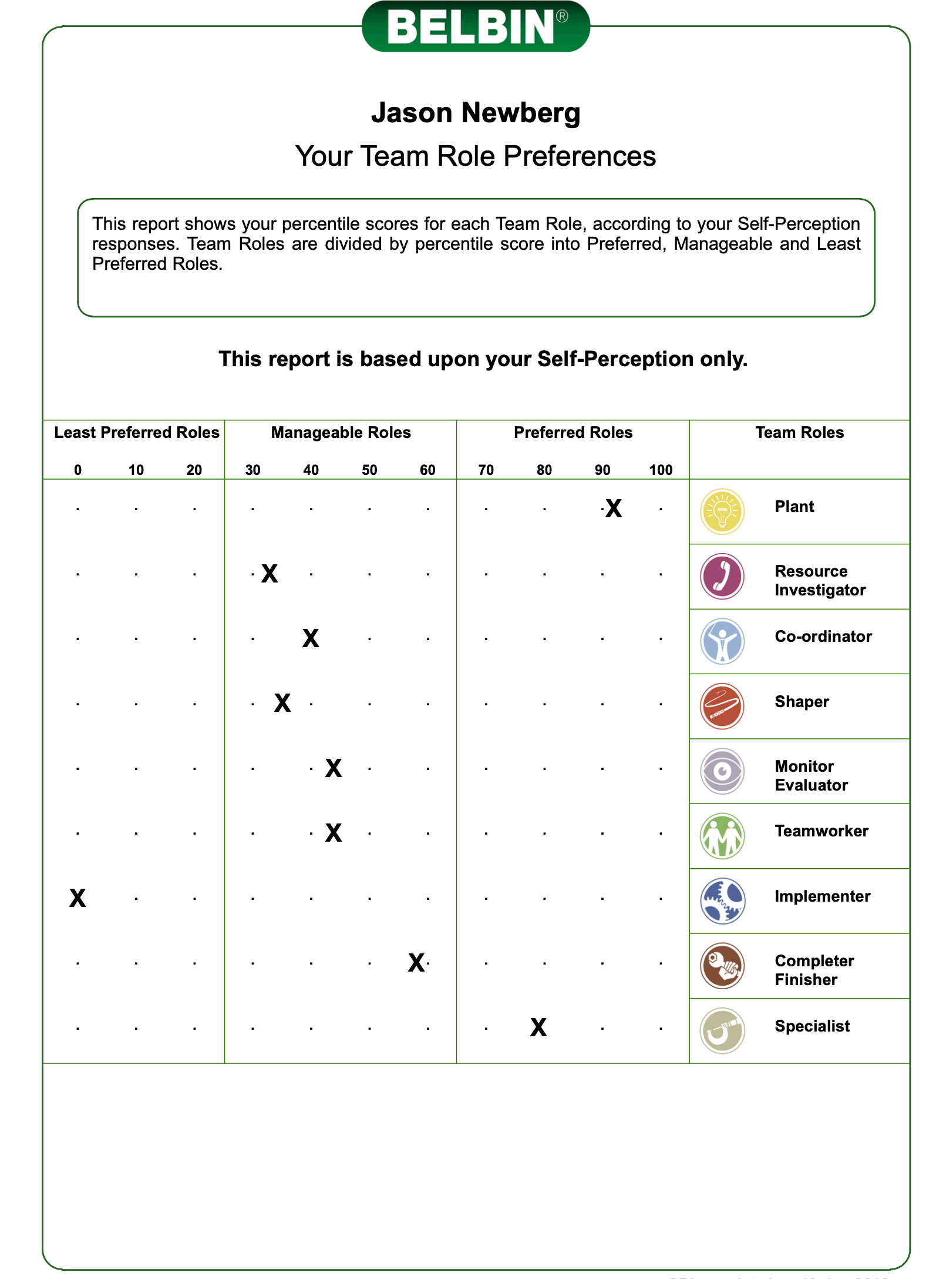

Slide 15
Activity 1: Role Mapping & Reflection
• Reflect on your strengths and identify which Belbin roles resonate with you
• Share with your group and discuss how these roles have influenced past team successes
What

Slide 16
Tying conflict to hackman
Conflict is inevitable in any team, and if not managed well, it can undermine everything that makes a team effective. Here’s why we focus on conflict resolution strategies in relation to Hackman’s model and team effectiveness:
1. Preserving a Supportive Context:
Hackman’s conditions emphasize a supportive context—ensuring that team members have the resources, feedback, and environment they need. Effective conflict resolution (through strategies like active listening and empathy) helps maintain that supportive context by preventing disagreements from escalating into destructive conflicts.
2. Maintaining a Shared Mindset:
A shared mindset, another key condition, means that everyone is aligned on the team’s purpose and values. Conflict resolution techniques, such as interest-based negotiation and finding common ground, ensure that differences in opinion are used constructively rather than fracturing the team’s unity.
3. Enhancing the Enabling Structure:
Clear processes and defined roles are part of an enabling structure. Conflict resolution strategies—like using “I” statements—reinforce clear, respectful communication, which is essential for the structure to work effectively even when tensions rise.
4. Opportunities to Learn:
Hackman’s model includes continuous learning as a vital condition. Well-managed conflicts can actually drive innovation and improvement by prompting deep discussion and critical thinking. When teams resolve conflicts constructively, they turn potential setbacks into learning opportunities.
5. Real-World Relevance:
For associates in large organizations, conflicts are a common reality. Focusing on conflict resolution strategies provides practical tools that you can use every day to contribute to a healthy team environment—directly supporting the conditions of effective teams as described by Hackman and expanded by Wageman.
In short, we selected conflict resolution strategies because they directly support and sustain the conditions for team effectiveness. They’re not the only important tools, but managing conflict well is essential for preserving trust, structure, and a shared purpose within any high-performing team.

Slide 17
Reversing Entropy – Conflict Resolution Strategies
• Active Listening: Fully focus and reflect back what you hear
Research: Rogers & Farson – builds mutual understanding
• Empathy: Validate and acknowledge others’ perspectives
Research: Goleman’s Emotional Intelligence – key for trust
• “I” Statements: Express your needs without blame
Based on: Rosenberg’s Nonviolent Communication
• Interest-Based Negotiation: Focus on underlying needs for win-win outcomes
Based on: Fisher & Ury’s Getting to Yes
• Brainstorming Alternatives: Generate creative, multiple solutions
Research: Osborn’s brainstorming techniques
• Finding Common Ground: Identify shared goals to build consensus
Research: Integrative negotiation models
Notes:
Conflict is inevitable, but when managed well, it strengthens a team. These strategies help ‘reverse entropy’—turning disorder into opportunity. Active listening and empathy build trust and understanding; using ‘I’ statements prevents blame and encourages open dialogue. Interest-based negotiation and brainstorming alternatives pave the way for creative solutions, while finding common ground unites diverse perspectives. These techniques help sustain the supportive context and shared accountability that effective teams need.

Slide 18
Inversion in Action – Bridging Research to Practice
• Effective teams thrive on clear direction, structure, and support
• Conflict resolution strategies maintain and enhance these conditions
• These tools foster deep discussion, critical thinking, and collaborative decision-making
----
• Deep Discussion & Critical Thinking:
• Driven by a compelling direction and enabling structure.
• Effective Conflict Resolution:
• Built through supportive context and expert coaching.
• Collaborative Decision-Making:
• Enabled by shared accountability and dynamic coaching.
• Clear Communication:
• Fostered through active listening, empathy, and fluid role-playing.
Notes:
Let’s connect the dots. The conditions defined by Hackman and enhanced by Wageman create the ideal team environment. Conflict resolution strategies are the tools that maintain that environment—they help you manage disagreements, preserve trust, and promote innovation. In other words, when you use these tools, you’re directly supporting the very conditions that make teams effective, enabling deep discussion and collaborative decision-making.
These research findings inform our learning objectives. A clear vision and structured processes foster deep discussion and critical thinking. Supportive environments and coaching make conflict resolution possible. Shared accountability and dynamic leadership drive collaborative decision-making, and clear communication—through active listening and empathy—is key to success. Our upcoming activities are designed to let you practice these skills in real scenarios.

Slide 19
Agents of Change – Fluid Roles & Individual Contributions (Belbin)
• Fluid Roles:
• Roles are not fixed; you “play” the role as needed
• Your unique contributions help shape team success
• Individual Contributions:
• Every team member’s strengths matter
• Your role is dynamic and shifts with the situation
• Fluid Roles in Practice:
• Play the mediator role when resolving conflicts
• Switch to a creative role during brainstorming
• Embrace situational leadership, regardless of title
Notes:
Belbin’s model highlights the diverse ways individuals contribute to a team. Whether you’re a creative ‘Plant’ or a detail-oriented ‘Completer Finisher,’ remember that these roles are fluid. You might ‘play the mediator role’ during a conflict and switch to an innovative role during brainstorming. Recognizing and leveraging your strengths is essential to creating a supportive, high-performing team environment.
“In every team, each member brings unique strengths. Instead of fixed roles, think of your role as fluid—today you might be a mediator, tomorrow a creative problem-solver. This adaptability is essential for fostering effective team dynamics, and even as associates, your proactive contributions can shape a positive team environment.

Slide 20
Tying roles to conflict
Introducing Belbin roles into your presentation and conflict scenarios offers several key benefits:
• Clarifies Individual Contributions:
Belbin roles provide a framework for understanding the diverse ways team members naturally contribute. This helps associates see that conflicts often arise not from personal shortcomings but from different, complementary strengths.
• Encourages Role Fluidity:
Emphasizing that roles are fluid—not fixed titles—reinforces that individuals can “play the mediator role” in one situation and switch to a creative role in another. This flexibility is crucial for navigating conflict and finding innovative solutions.
• Facilitates Self-Awareness:
When associates reflect on which Belbin roles resonate with them, they become more aware of their own strengths and areas for growth. This self-awareness supports better communication and conflict resolution because team members understand their contributions and how they can best support the team.
• Enhances Conflict Simulation:
In your conflict scenarios, assigning role cards (including a distractor role) based on Belbin’s model adds a layer of realism. It challenges participants to negotiate and collaborate while accounting for differing perspectives and behaviors—mirroring real-life team dynamics.
• Bridges Theory and Practice:
Using Belbin roles ties back to your overall themes of team dynamics and effective conflict management. It shows that while research (like Hackman’s conditions) outlines what makes teams work, understanding individual roles helps you apply that research in day-to-day interactions and conflict resolution.
In short, Belbin roles are a practical tool that makes abstract concepts about team effectiveness tangible, giving associates actionable insights into how they can contribute to, and shape, a high-performing team environment.

Slide 21
Activity 2: Conflict Resolution Scenarios

Slide 22
Leading from Within – Your Impact as Team Leaders
• Shape the Enabling Structure:
• Clarify roles, processes, and expectations
• Promote organized, effective teamwork
• Cultivate a Supportive Context:
• Share resources, celebrate successes, and encourage open dialogue
• Build an environment where every voice is valued
• Foster Shared Accountability:
• Encourage collective responsibility for team outcomes
• Inspire a culture of mutual support and commitment
• Embrace Coaching:
• Offer constructive feedback and mentorship
• Empower peers through continuous learning and adaptive leadership

Slide 23
Not a slide, just info
1. Preserving a Supportive Context:
Hackman’s conditions emphasize a supportive context—ensuring that team members have the resources, feedback, and environment they need. Effective conflict resolution (through strategies like active listening and empathy) helps maintain that supportive context by preventing disagreements from escalating into destructive conflicts.
2. Maintaining a Shared Mindset:
A shared mindset, another key condition, means that everyone is aligned on the team’s purpose and values. Conflict resolution techniques, such as interest-based negotiation and finding common ground, ensure that differences in opinion are used constructively rather than fracturing the team’s unity.
3. Enhancing the Enabling Structure:
Clear processes and defined roles are part of an enabling structure. Conflict resolution strategies—like using “I” statements—reinforce clear, respectful communication, which is essential for the structure to work effectively even when tensions rise.
4. Opportunities to Learn:
Hackman’s model includes continuous learning as a vital condition. Well-managed conflicts can actually drive innovation and improvement by prompting deep discussion and critical thinking. When teams resolve conflicts constructively, they turn potential setbacks into learning opportunities.
5. Real-World Relevance:
For associates in large organizations, conflicts are a common reality. Focusing on conflict resolution strategies provides practical tools that you can use every day to contribute to a healthy team environment—directly supporting the conditions of effective teams as described by Hackman and expanded by Wageman.

